Slide 1

Analysis of Online Advertising Performance

Slide 2
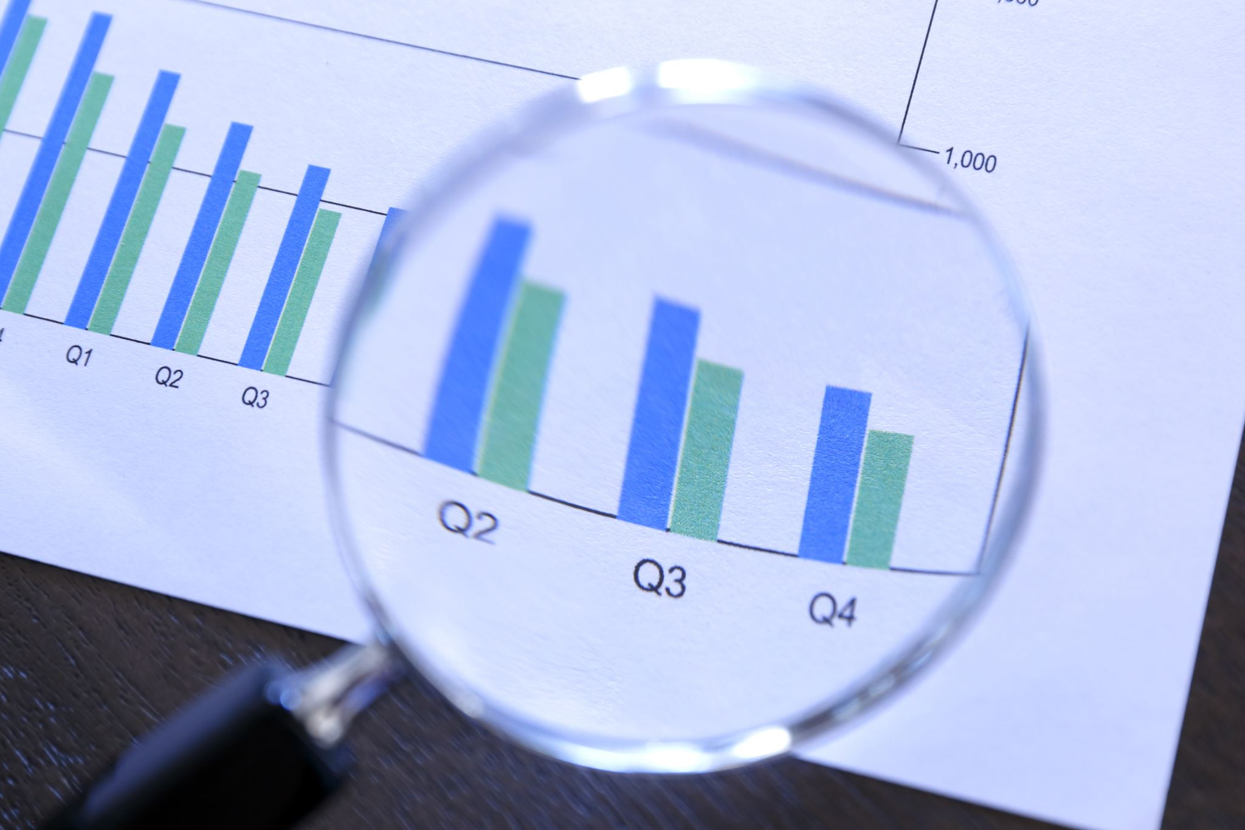
Contents
1. Introduction
2. User Engagement Trend
3. Banner Performance
4. Placement Performance
5. Correlation Analysis
6. Campaign Performance
7. Revenue Analysis
8. User Engagement by Banners
9. Placement Conversion Rates
10. Daily Sales Analysis
11. Conclusion

Slide 3

Introduction
This presentation provides an in-depth analysis of the online advertising performance data. It focuses on user engagement trends, banner and placement performance, post-click conversions, and cost-effectiveness across various campaigns and placements.

Slide 4
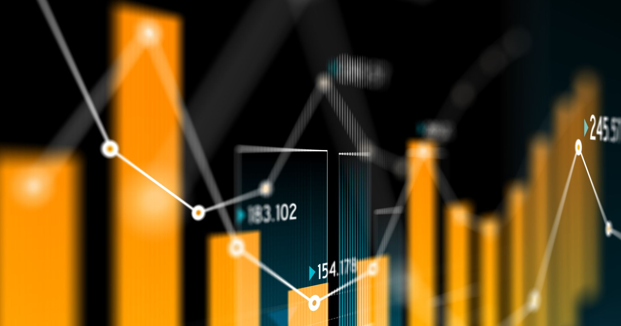
User Engagement Trend
We analyzed user engagement trends over time by grouping data by date and user engagement level. The analysis revealed patterns in high, medium, and low engagement levels.

Slide 5
Average Clicks by Banner Size
160 x 600
Average Clicks: 132.73
Banner Performance
Average Clicks: 459.07
300 x 250
Average Clicks: 145.82

Slide 6
Placement Performance Clicks and Displays by Placement
abc
def
ghi
mno
Displays: 242,142, Clicks: 1,584
Displays: 28,177,492, Clicks: 176,097
Displays: 59,740,415, Clicks: 1,247,049
Displays: 143,161,775, Clicks: 993,039

Slide 7
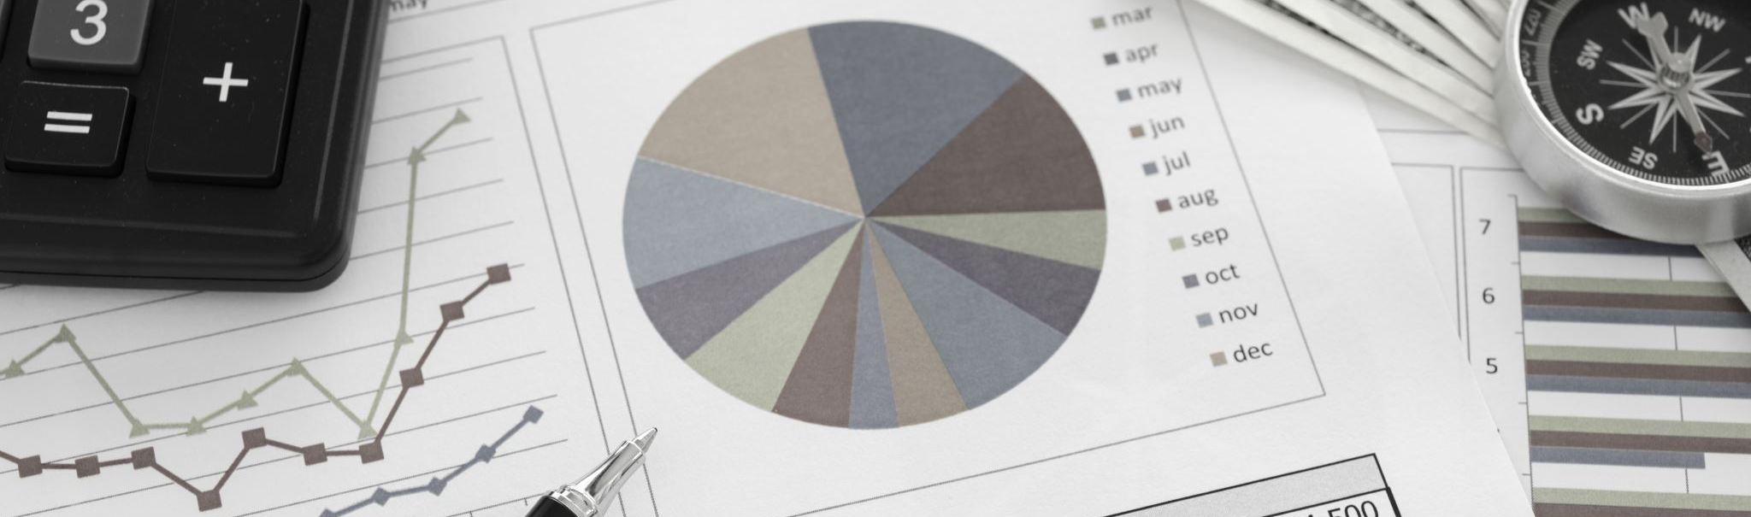
Correlation Analysis
The correlation between cost and revenue was found to be 0.76, indicating a strong positive relationship. This suggests that higher costs are associated with higher revenue in the advertising campaigns analyzed.

Slide 8
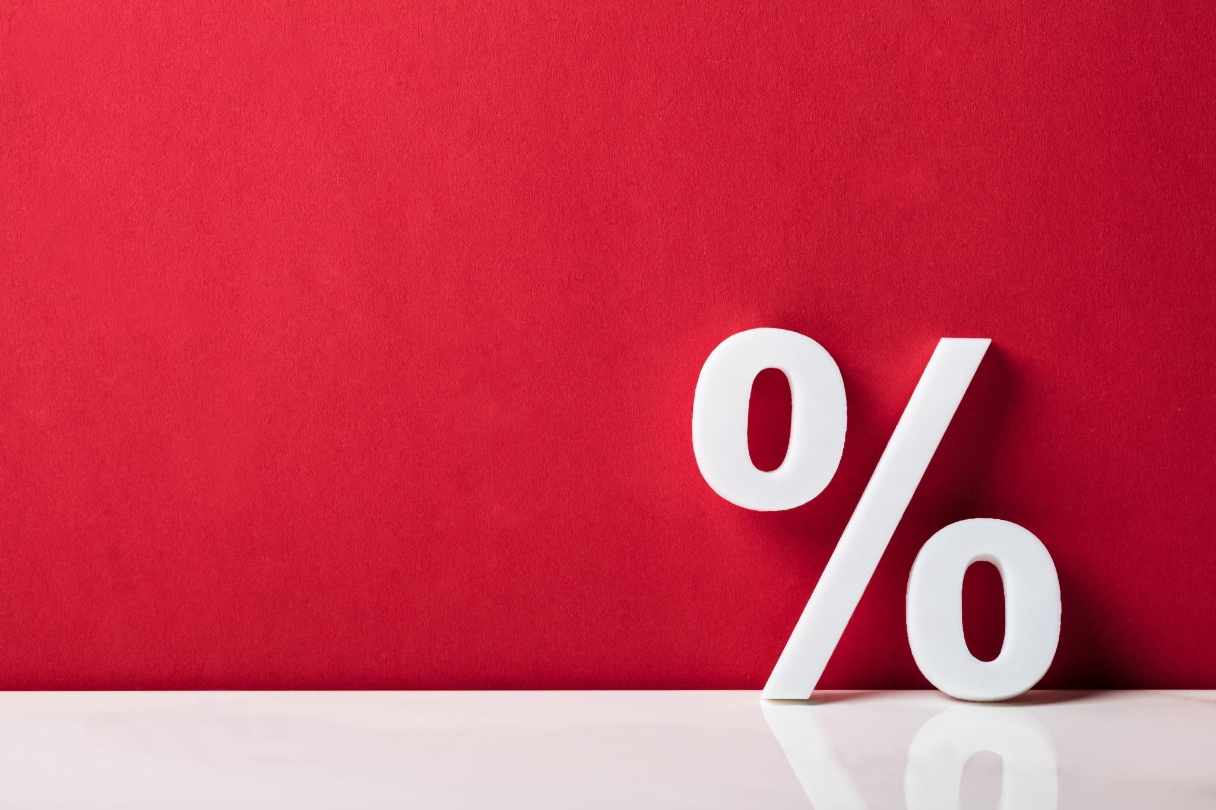
Campaign Performance Conversion Rates by Campaign
Campaign 1:Conversion Rate: 44.93%
Campaign 2:Conversion Rate: 1.56%
Campaign 3:Conversion Rate: 2.43%

Slide 9

Revenue Analysis
The total revenue generated from the advertising campaigns was $276,264.27. The average revenue per click was calculated to be $0.11. This metric helps in understanding the efficiency of the ad spending.

Slide 10

User Engagement by Banners
Analysis of user engagement levels across different banner sizes revealed that the 728 x 90 banners had the highest engagement levels. This insight can help in optimizing banner sizes for future campaigns.

Slide 11

Placement Conversion Rates
Among different placement types, placement 'abc' had the highest post-click conversion rate at 52.02%. Other placements like 'def' and 'ghi' also showed significant conversion rates, indicating the effectiveness of specific placements.

Slide 12
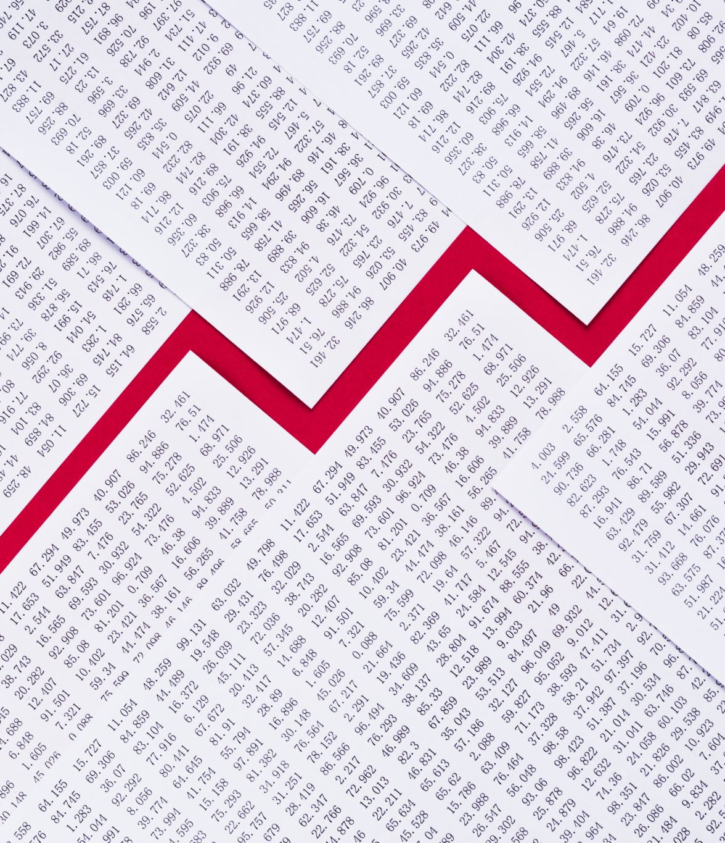
Daily Sales Analysis
Daily sales analysis showed fluctuations in post-click sales amounts over time. These fluctuations can be attributed to various factors, including the day of the week, campaign strategies, and user behavior.

Slide 13

Conclusion
The analysis provides valuable insights into online advertising performance. By understanding trends in user engagement, banner and placement effectiveness, and conversion rates, we can optimize future advertising strategies for better ROI.

